Slide 1

Exploratory data analysis

Slide 2
what is exploratory data analysis (EDA)?
We will discuss how to use visualization and transformation to understand data by exploring it in a systematic way
EDA is an iterative process:
Generate questions about your data
Search for answers by visualizing, transforming, and modelling data
Use what you learn to refine your questions or generate new ones
Some comments about EDA:
It is not a formal process with a strict set of rules
Explore many ideas: some will pay out, others will be dead ends
Even if questions are predefined, quality of data still needs to be assessed

Slide 3
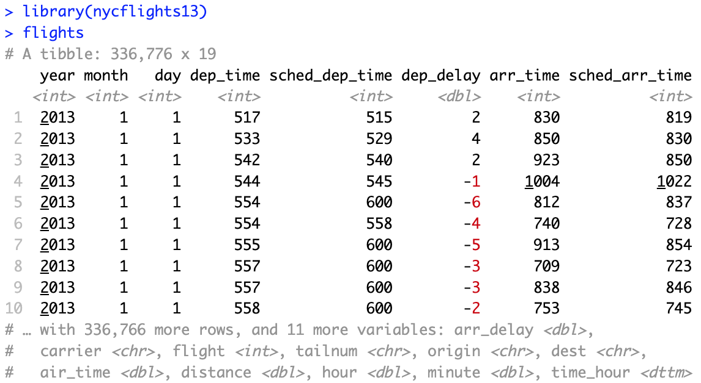
ask many questions
Key to asking quality questions: ask many questions
Two types of questions may be generally useful:
What type of variation occurs within the variables?
What type of covariation occurs between the variables?
Clarifying some definitions:
Variable: a quantity, quality, or property that you can measure
Value: the state of a variable when you measure it
Observation: set of variable measurements made under similar conditions
Tabular data: a set of values, each associated with a variable and an observation
Tidy as each value is placed in its own cell, each variable in its own column, and each observation in its own row
Example datasets: diamonds, nycflights13::flights

Slide 4
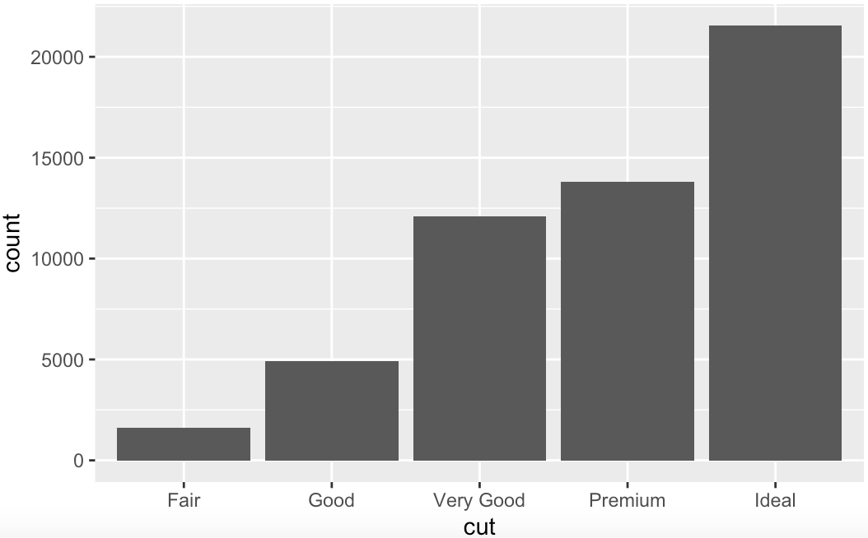
visualizing variation
Tendency of the values of a variable to change across measurements
How can you visualize the distribution of a variable?
It depends on whether it is categorical (factor or character) or continuous
To examine the distribution of a categorical variable, use a bar chart:

Slide 5
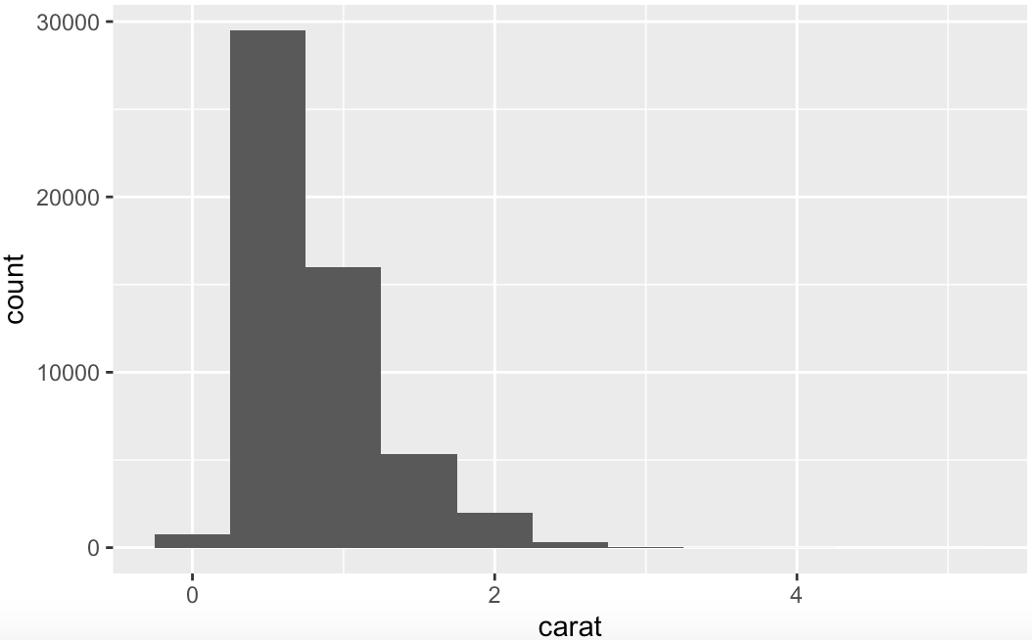
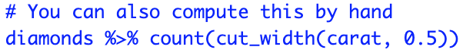
variation of a continuous variable
To examine the distribution of a continuous variable, use a histogram:

Slide 6
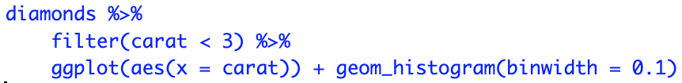
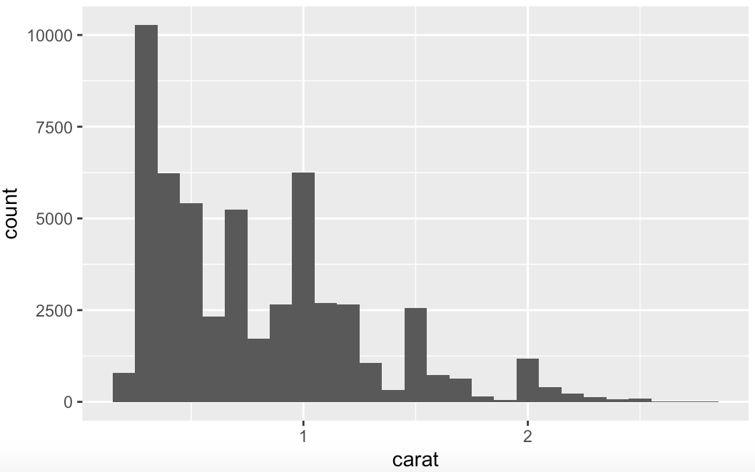
changing the resolution of a histogram
Set the width of the intervals with the binwidth argument
We can also zoom in to focus on smaller diamonds

Slide 7
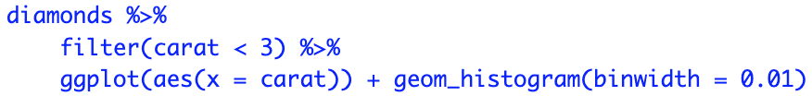
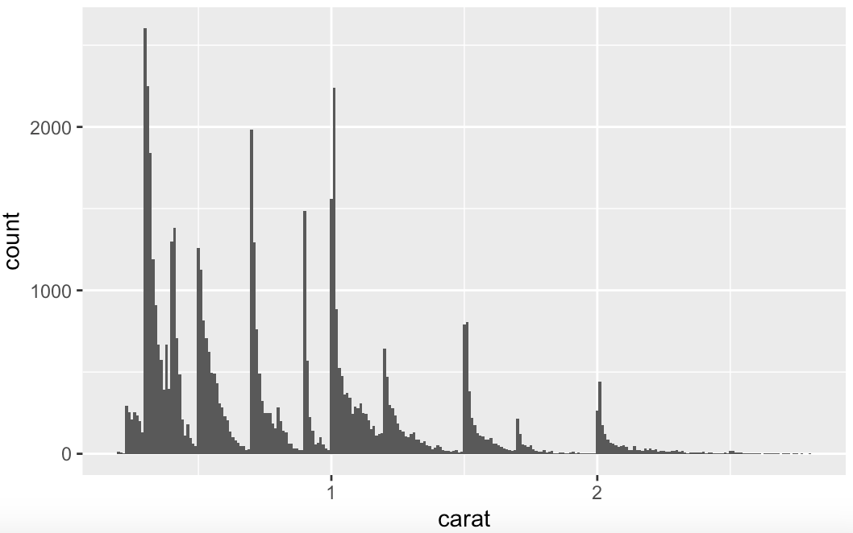
identifying typical values
Look for anything unexpected:
Which values are the most common? Why?
Which values are rare? Why? Does that match your expectations?
Can you see any unusual patterns? What might explain them?

Slide 8
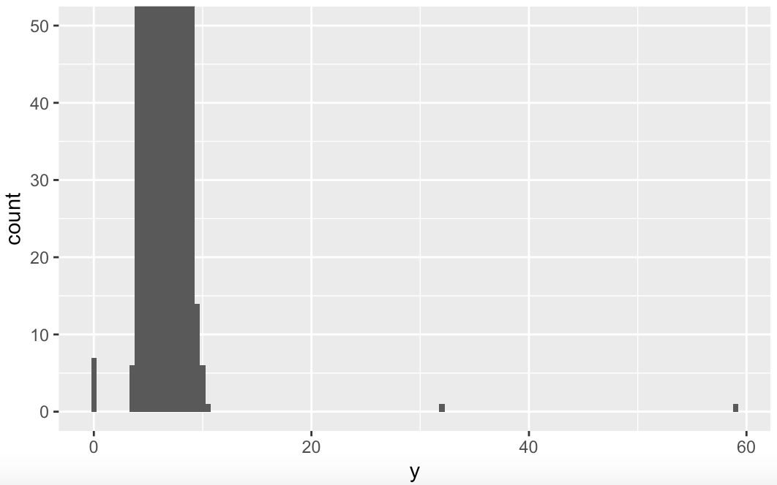
Identifying unusual values
Outliers are unusual observations, points that don’t seem to fit the pattern
Sometimes outliers are entry errors; other times, they can be interesting
Outliers are sometimes difficult to see in a histogram

Slide 9
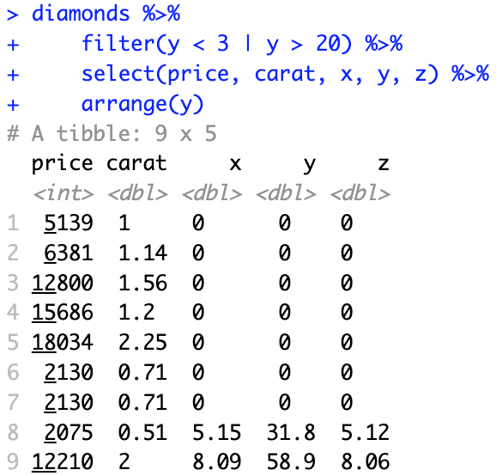
identifying outliers
Now that we have seen the unusual values, we can try to understand them
The y variable measures on of the three dimensions in mm
Therefore, there must be entry errors!
It’s good practice to repeat your analysis with and without the outliers

Slide 10
adding missing values
When you encounter unusual values, you have two options:
Drop the entire row with the strange values:
Replace the unusual values with missing values
ggplot2 will issue a warning when you plot with missing values
Note the use of the function ifelse

Slide 11
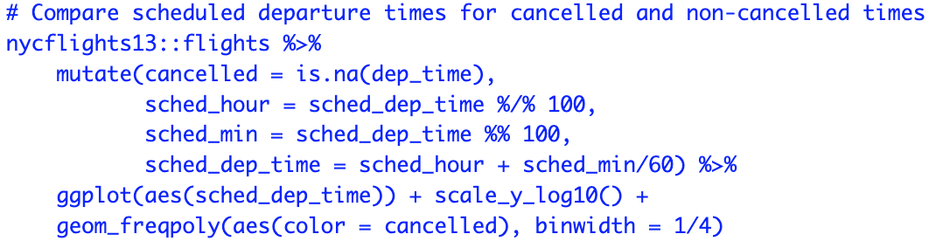
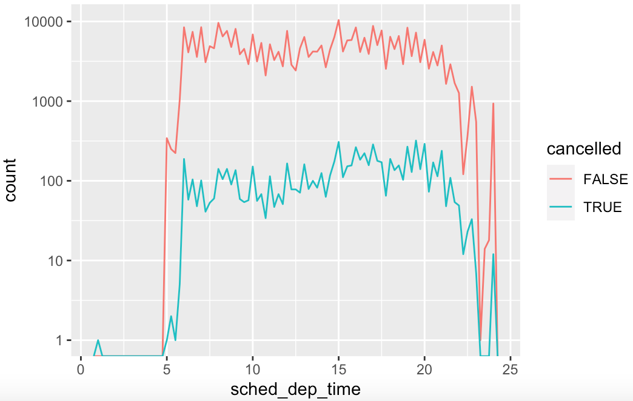
understanding missing values
What makes observations with missing values different?
For example, in flights, missing values in dep_time are for cancelled flights

Slide 12
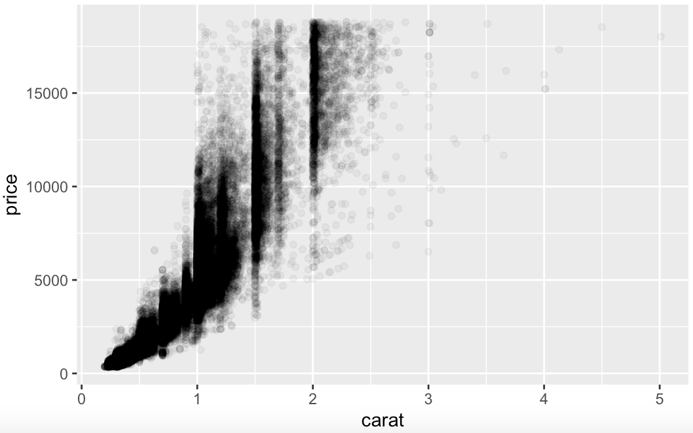
covariation
Tendency for the values of two or more variables to vary together
Two continuous variables: draw a scatteplot with geom_point()
Example: diamond dataset

Slide 13
boxplots
Distribution of a continuous variable broken down by a categorical variable

Slide 14
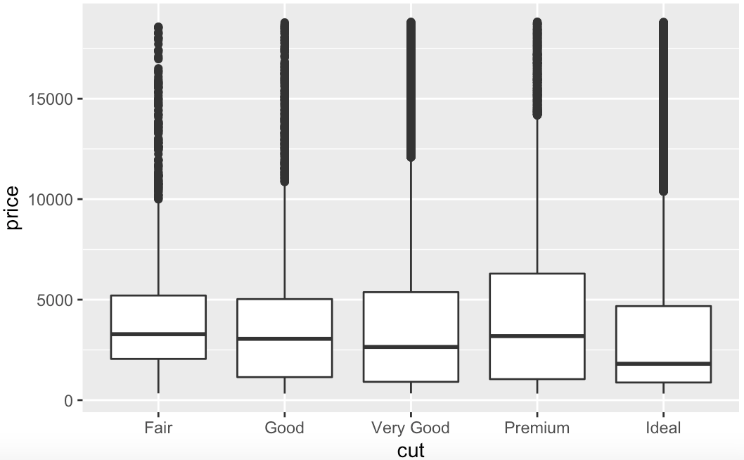
a categorical and a continuous variable
To display the covariation between a categorical and a continuous variable: use a boxplot

Slide 15
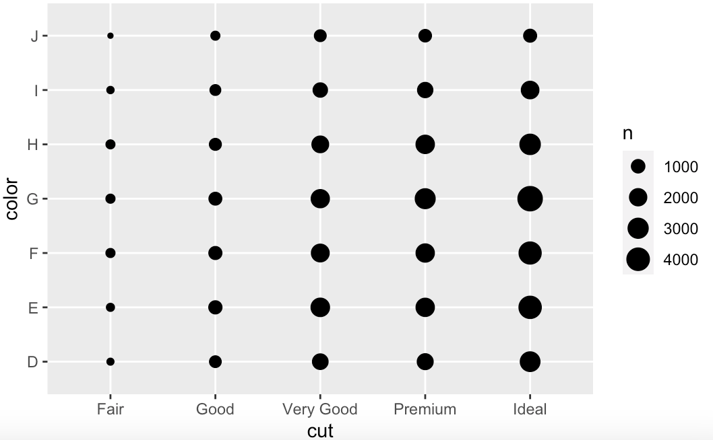
two categorical variables
To display covariation between two categorical variables: geom_count()
Circle size: how many observations occurred at each combination of values

Slide 16
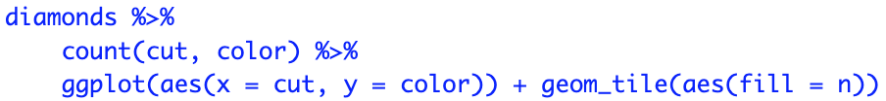
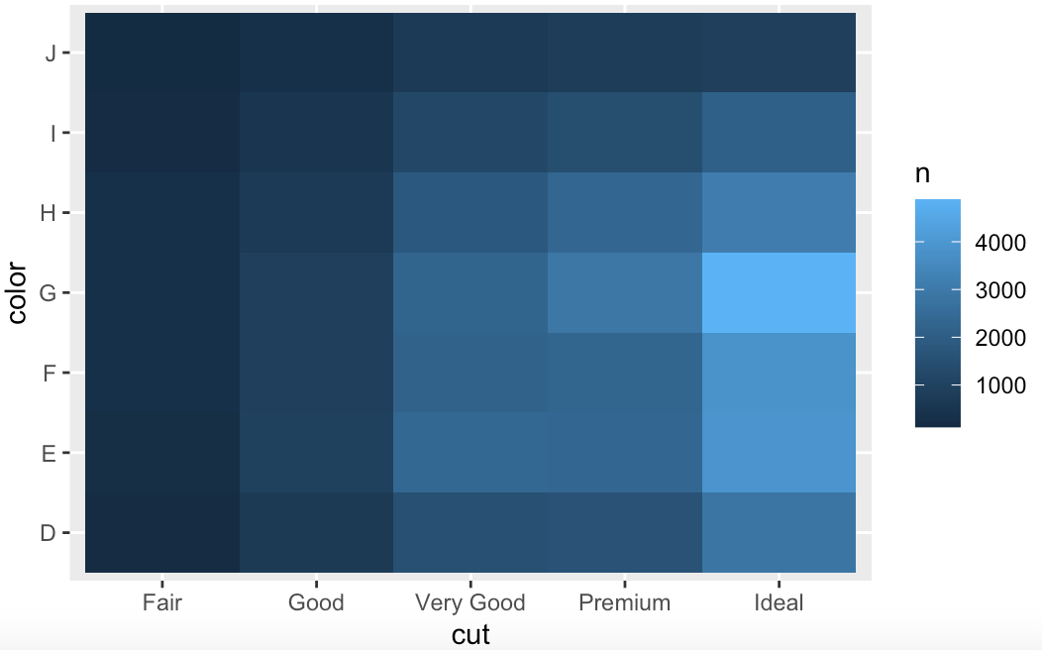
two categorical variables
Alternatively, to display covariation between two categorical variables, compute the count with dplyr

Slide 17
understanding patterns
If a systematic relationship exists between two variables, it will appear as a pattern in the data
If you spot a pattern, ask yourself:
Could this pattern be due to random change?
How can you describe the relationship implied by the pattern?
How strong is the relationship implied by the pattern?
What other variables might affect the relationship?
What changes if you look at individual subgroups of the data?

Slide 18
model basics

Slide 19
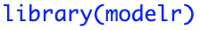
introduction to models
The goal of a model is to provide a simple low-dimensional summary of a dataset, which we can use to partition data into patterns and residuals
There are two parts to a model:
Define a family of models: type of pattern that you want to capture
Generate a fitted model: the closest, within the family, to your data
We will use the modelr package, which wraps around base R’s modelling functions to make them work naturally in a pipe

Slide 20
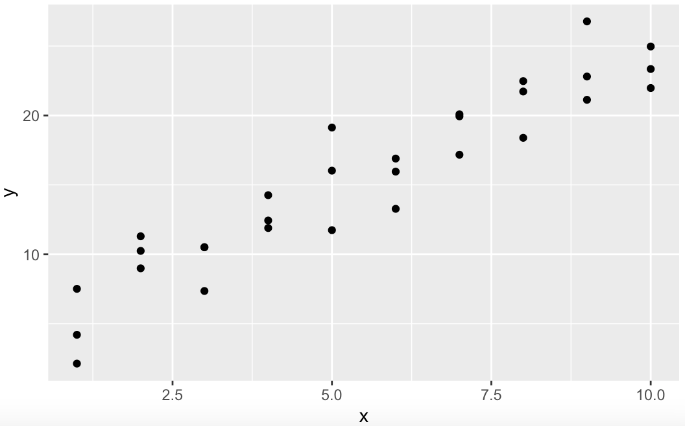
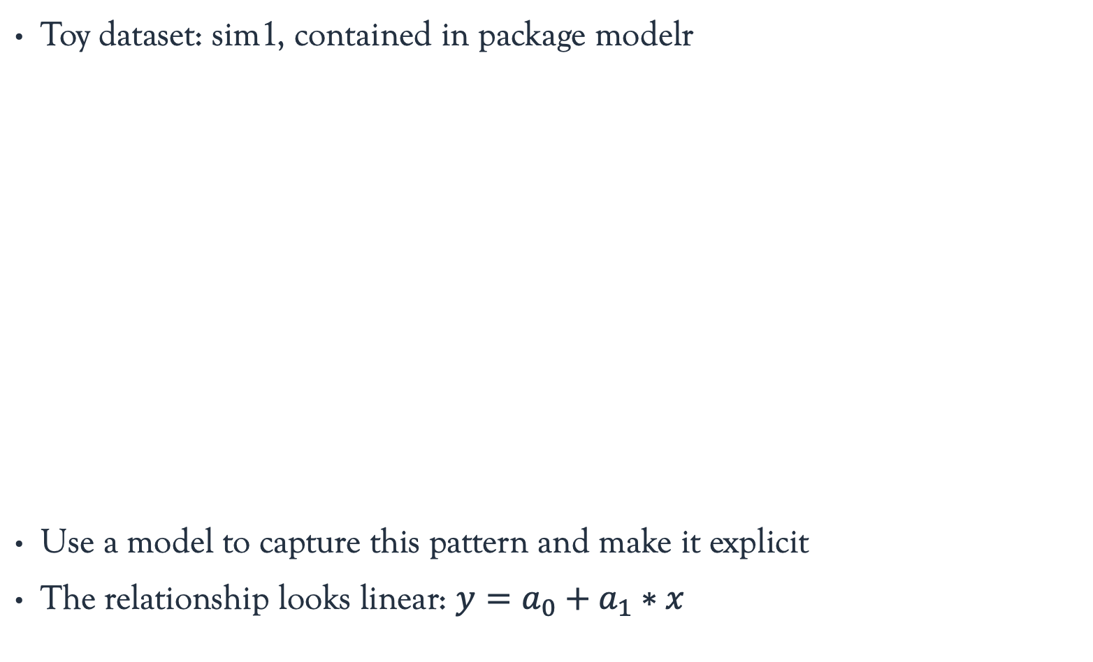
defining a family of models
Toy dataset: sim1, contained in package modelr
Use a model to capture this pattern and make it explicit
The relationship looks linear: $y=a_{0}+a_{1}∗x$

Slide 21

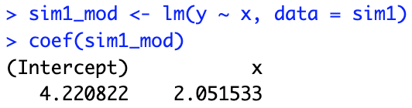
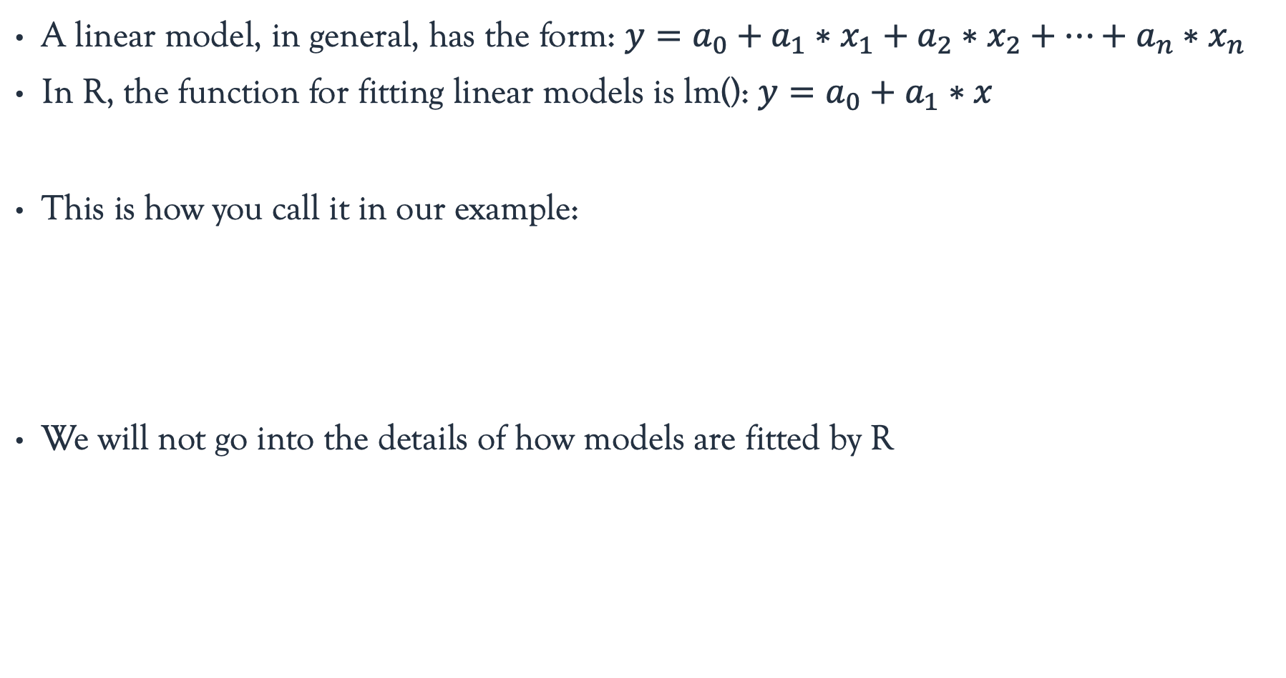
fitting linear models
A linear model, in general, has the form: $y=a_{0}+a_{1}∗x_{1}+a_{2}∗x_{2}+…+a_{n}∗x_{n}$
In R, the function for fitting linear models is lm(): $y=a_{0}+a_{1}∗x$
This is how you call it in our example:
We will not go into the details of how models are fitted by R

Slide 22
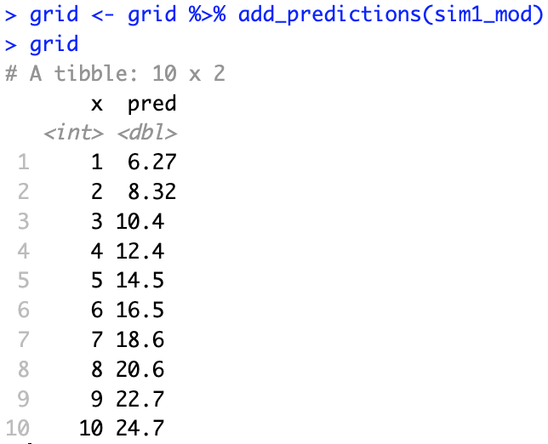
making predictions
First, generate a grid of values covering the region where our data lies
This finds unique values for each variable and generates all combinations
Now make predictions (using modelr) and add them to the grid data frame

Slide 23
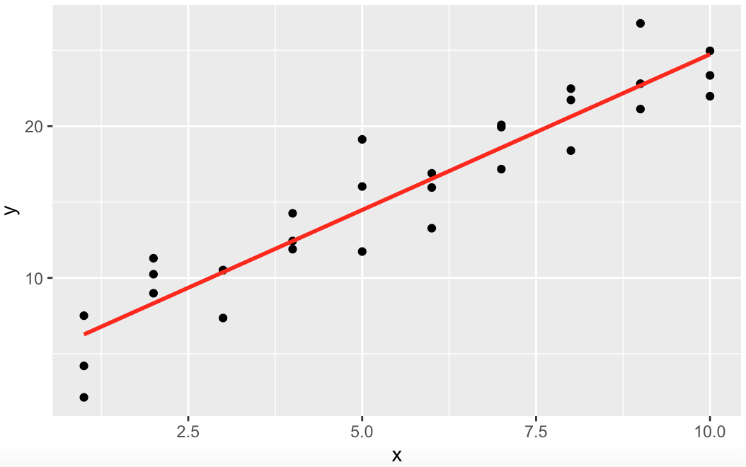
visualizing the predictions
Now, we can compare our predictions to the observed values

Slide 24
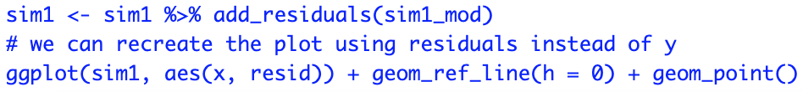
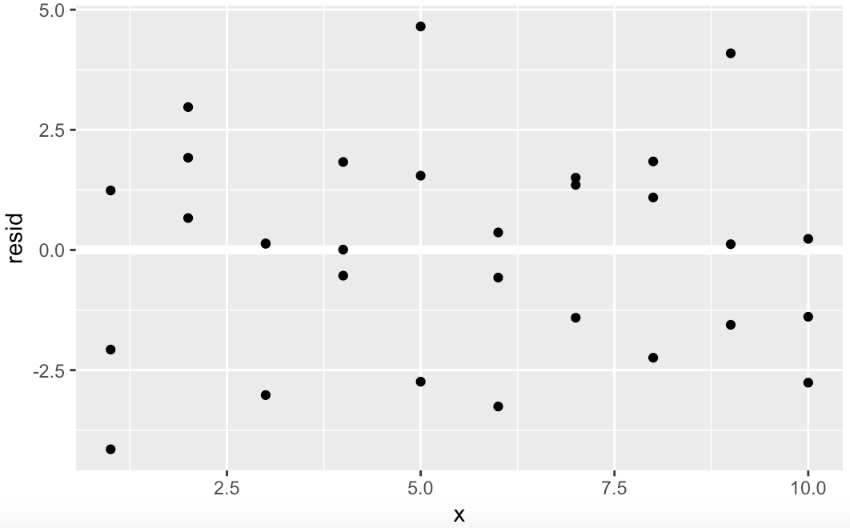
visualizing the residuals
Add residuals to data with add_residuals() from package modelr

Slide 25
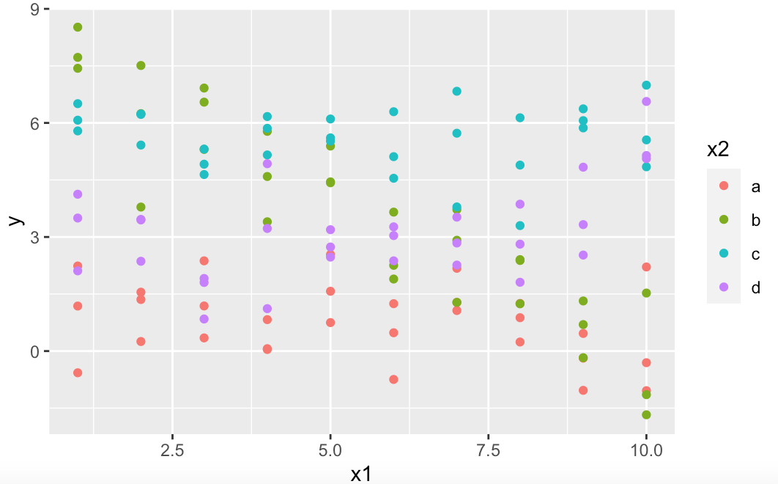
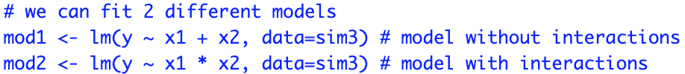
formulas with interactions
In the sim3 dataset, there is a categorical and a continuous predictor

Slide 26
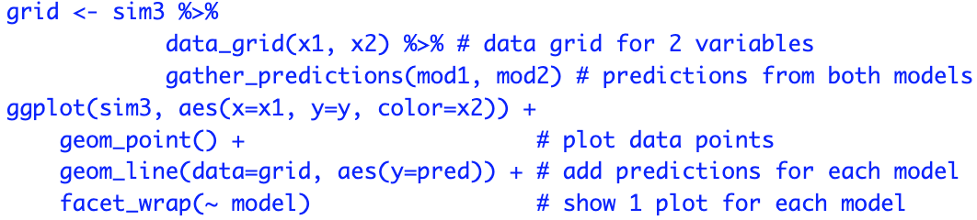
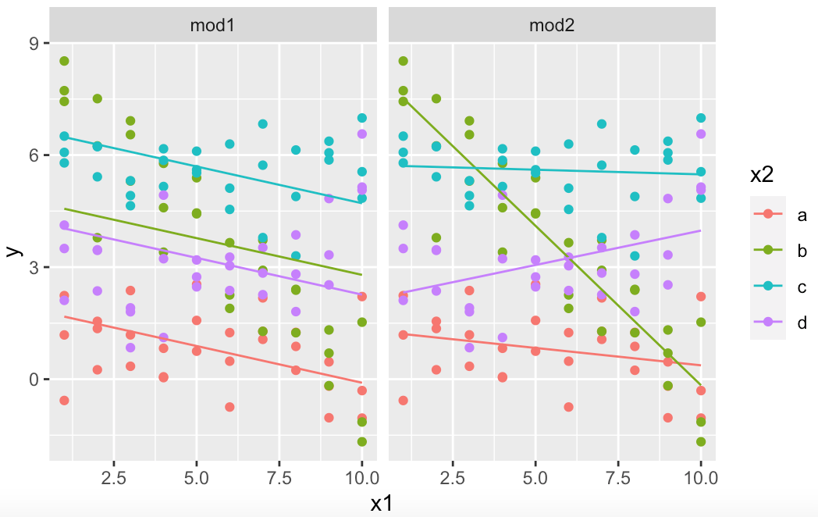
models with interactions
The model that uses the * has a different slope and intercept for each line

Slide 27
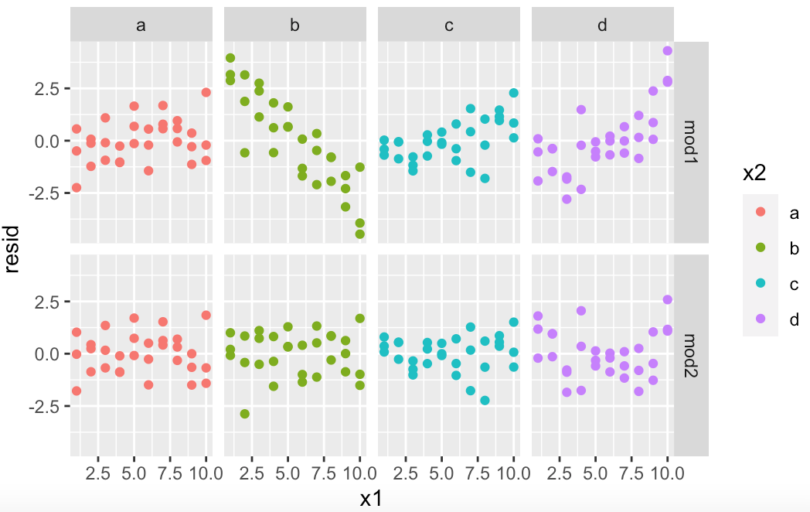
residuals with interactions
Which model should we choose? Let’s look at the residuals
There is little obvious pattern in the residuals for mod2

Slide 28
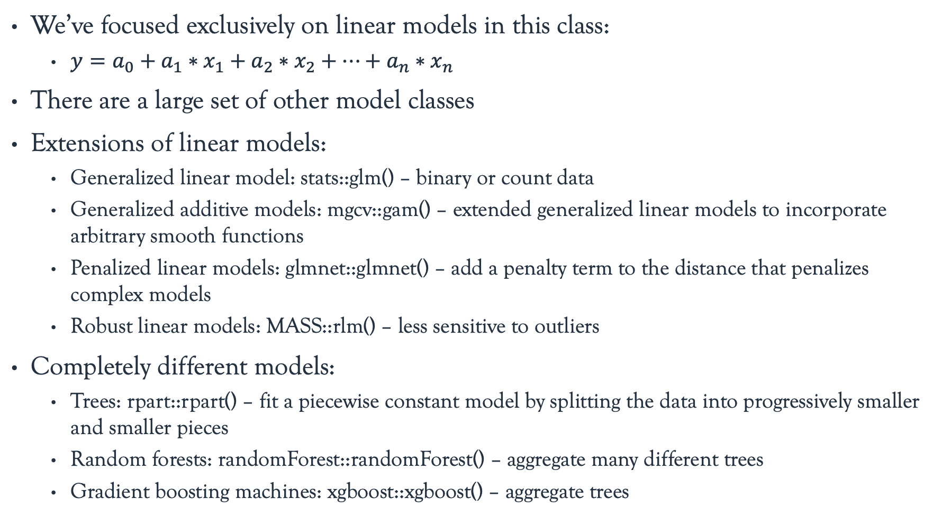
other model families
We’ve focused exclusively on linear models in this class:
$y=a_{0}+a_{1}∗x_{1}+a_{2}∗x_{2}+…+a_{n}∗x_{n}$
There are a large set of other model classes
Extensions of linear models:
Generalized linear model: stats::glm() – binary or count data
Generalized additive models: mgcv::gam() – extended generalized linear models to incorporate arbitrary smooth functions
Penalized linear models: glmnet::glmnet() – add a penalty term to the distance that penalizes complex models
Robust linear models: MASS::rlm() – less sensitive to outliers
Completely different models:
Trees: rpart::rpart() – fit a piecewise constant model by splitting the data into progressively smaller and smaller pieces
Random forests: randomForest::randomForest() – aggregate many different trees
Gradient boosting machines: xgboost::xgboost() – aggregate trees

Slide 29
model building

Slide 30
using models to understand data
We have introduced models using simulated data
Now, we will discuss how to progressively build up a model for real data
We will proceed iteratively:
Find patterns with visualization
Make them concrete and precise with a model
Repeat, replacing the old response variable with the residuals
Knowing when to stop is not easy
Our goal is to transition from implicit knowledge in the data and your head to explicit knowledge in a quantitative model
There are more automated ways, which are useful for very large and complex data

Slide 31
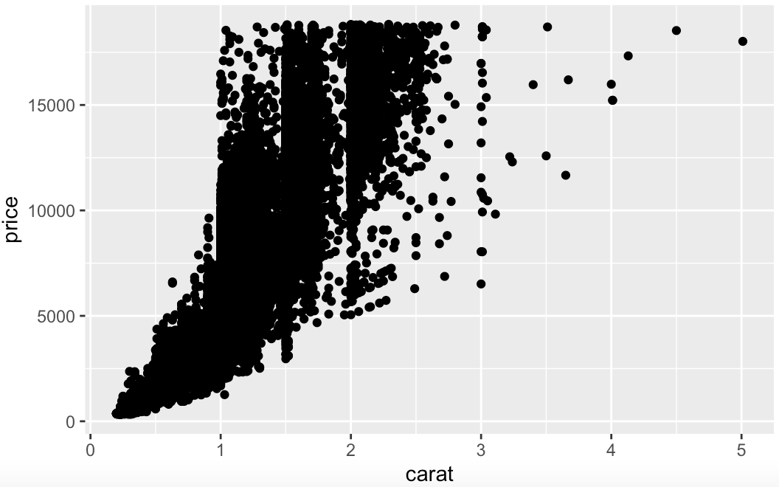
the diamond dataset
What determines the price of a diamond?
There is a strong relationship between carat and price

Slide 32
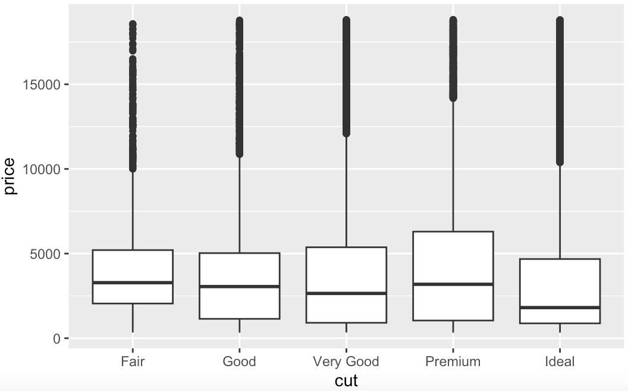
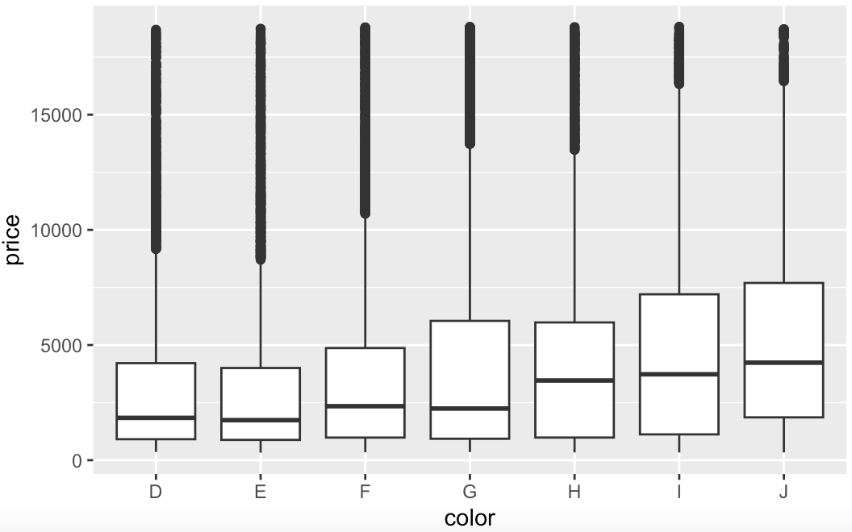
the diamond dataset
Why do low-quality diamonds appear more expensive?
Remember that diamond color goes from J (worst) to D (best)

Slide 33
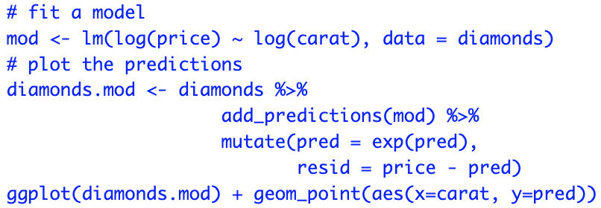
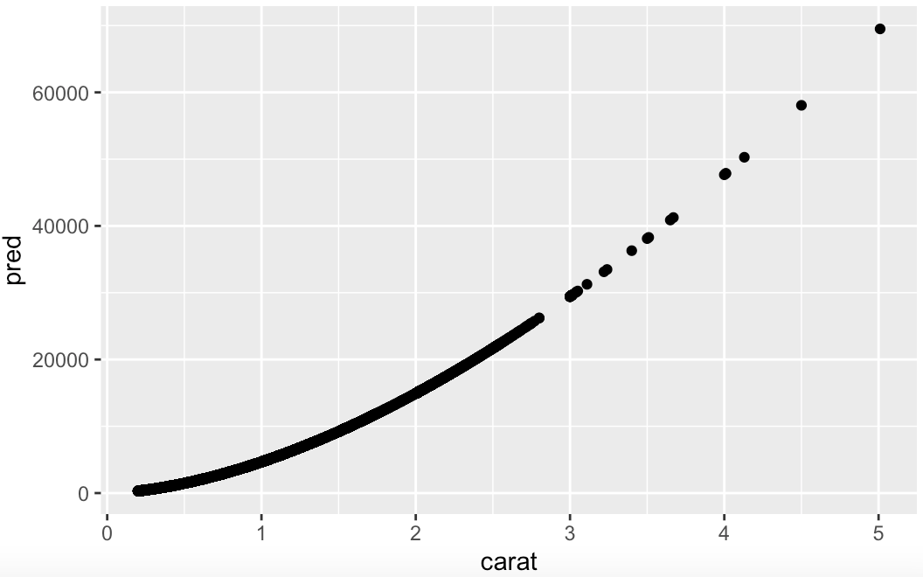
Patterns and models
It’s hard to understand the relationship between cut and price
Use a model to remove the very strong relationship between price and carat

Slide 34
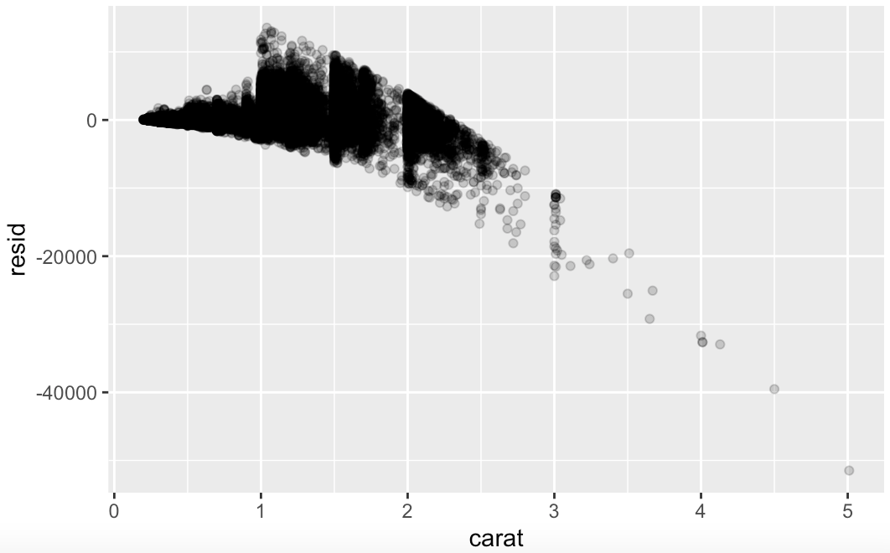
residuals
Residuals are the differences between the true and predicted price
This model seems to overestimate the price of large diamonds

Slide 35

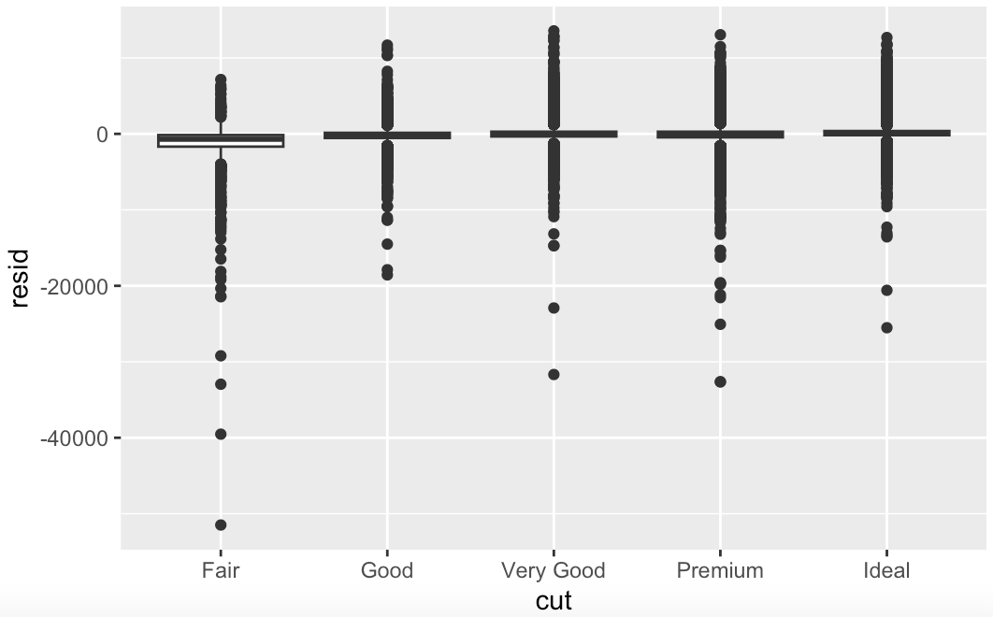
using residuals
Once you’ve removed the strong relationship between carat and price, you can see what you expect in the relationship between cut and price
Relative to their size, better quality diamonds are more expensive

Slide 36
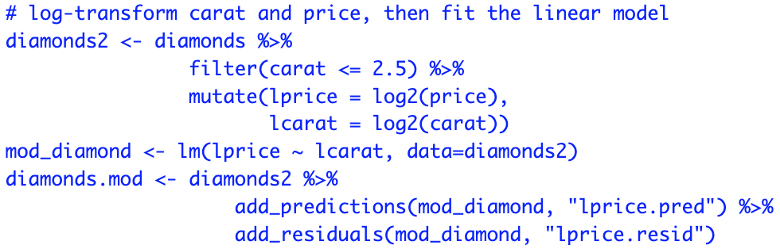
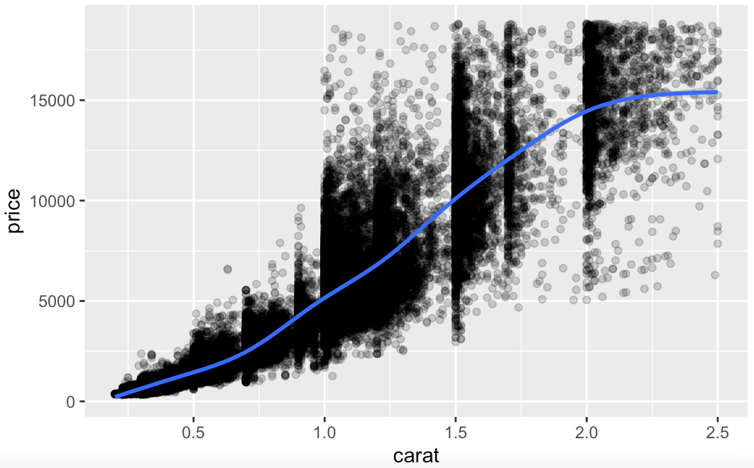
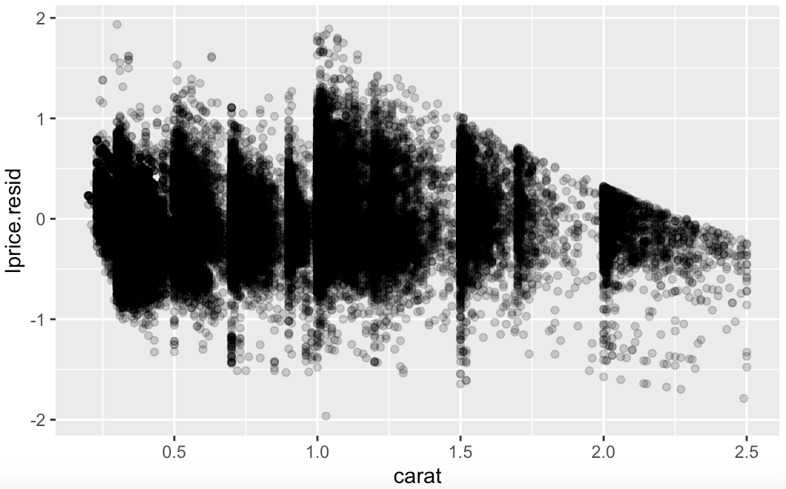
price and carat
Focus on diamonds smaller than 2.5 carats (99.7% of the data)

Slide 37
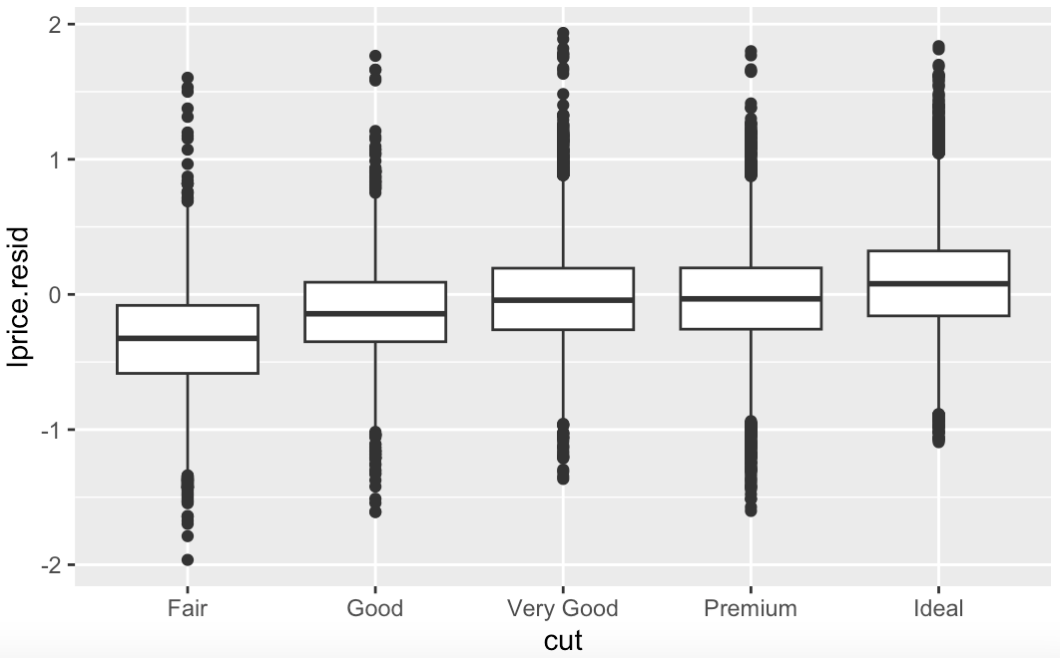
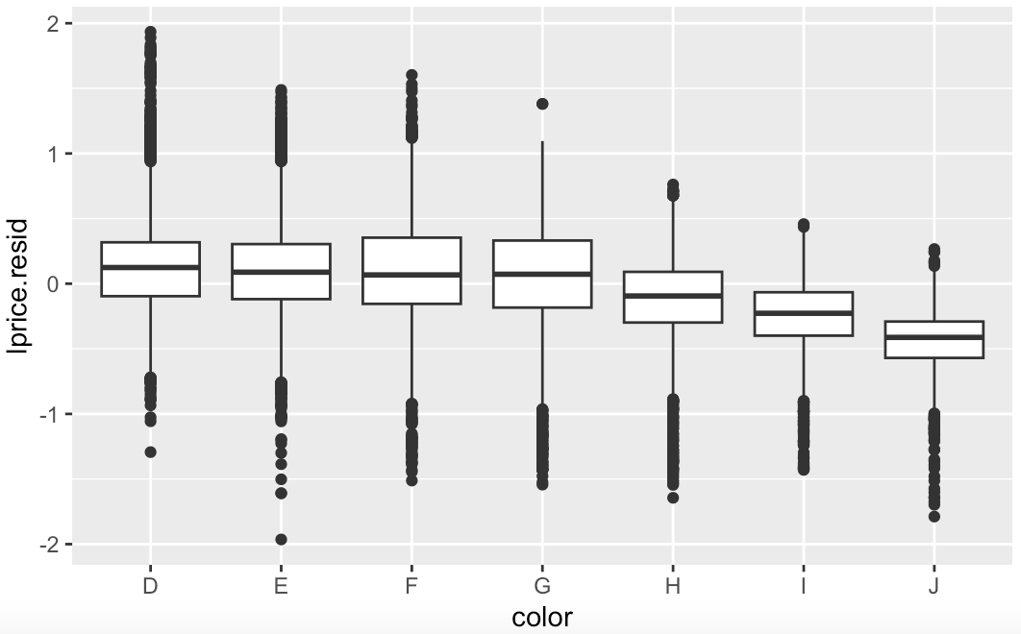
residuals
Now we see the relationship we expect: price increases with quality

Slide 38
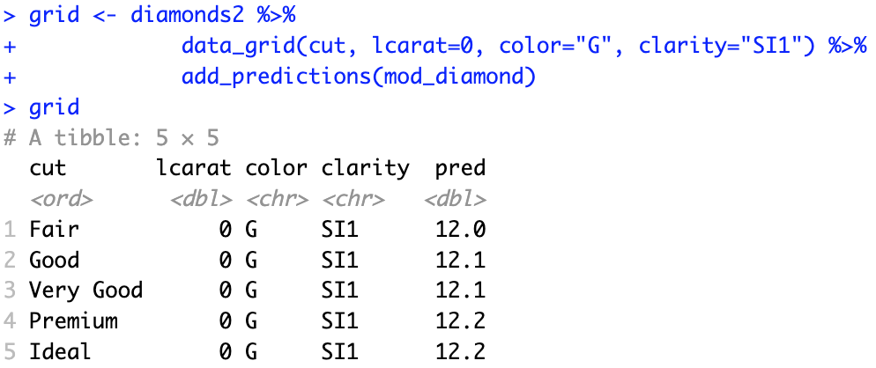
a more complicated model
Continue to build our model, making the observed effects explicit:
This model now includes 4 predictors, so it’s harder to visualize
Since there are no interaction terms, we can plot them individually in 4 plots
For example, we can plot the effect of “cut” with the other variables fixed

Slide 39
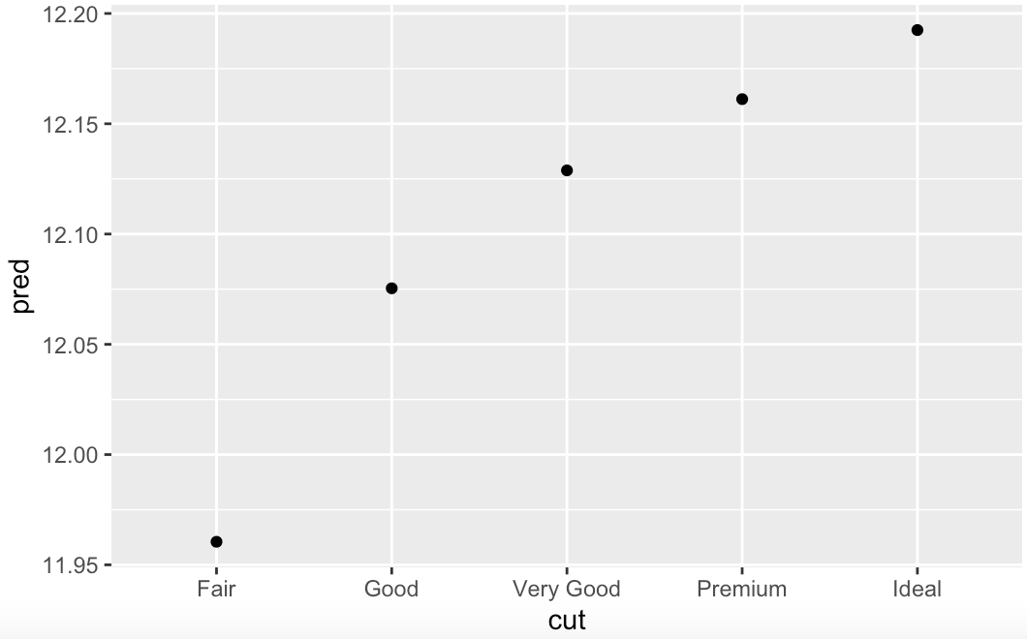
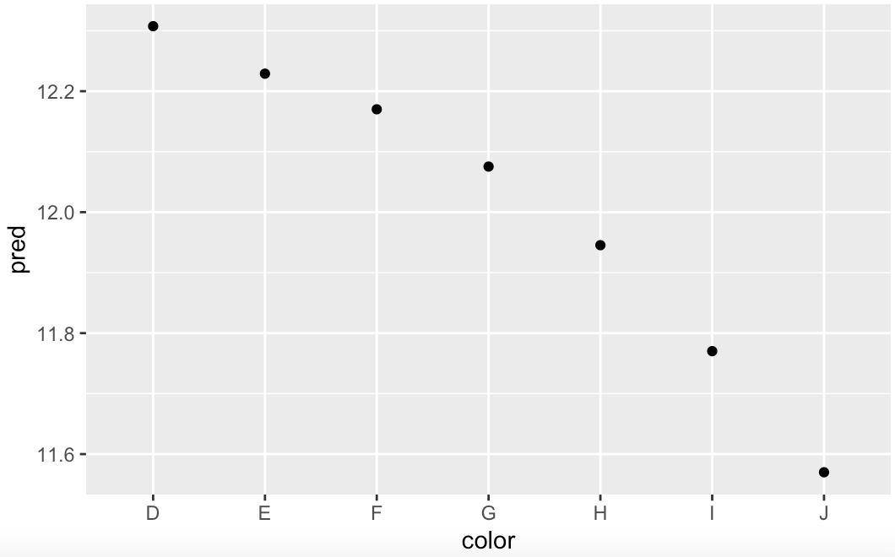
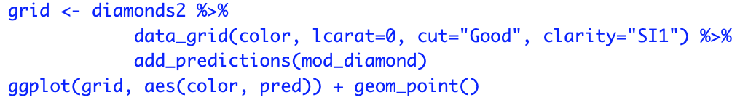
plotting effects in a more complicated model
Now we can plot the effect of each variable separately:
For the effect of color, we used:

Slide 40
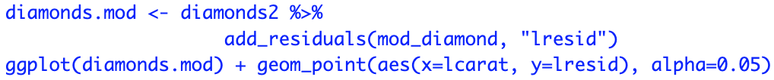
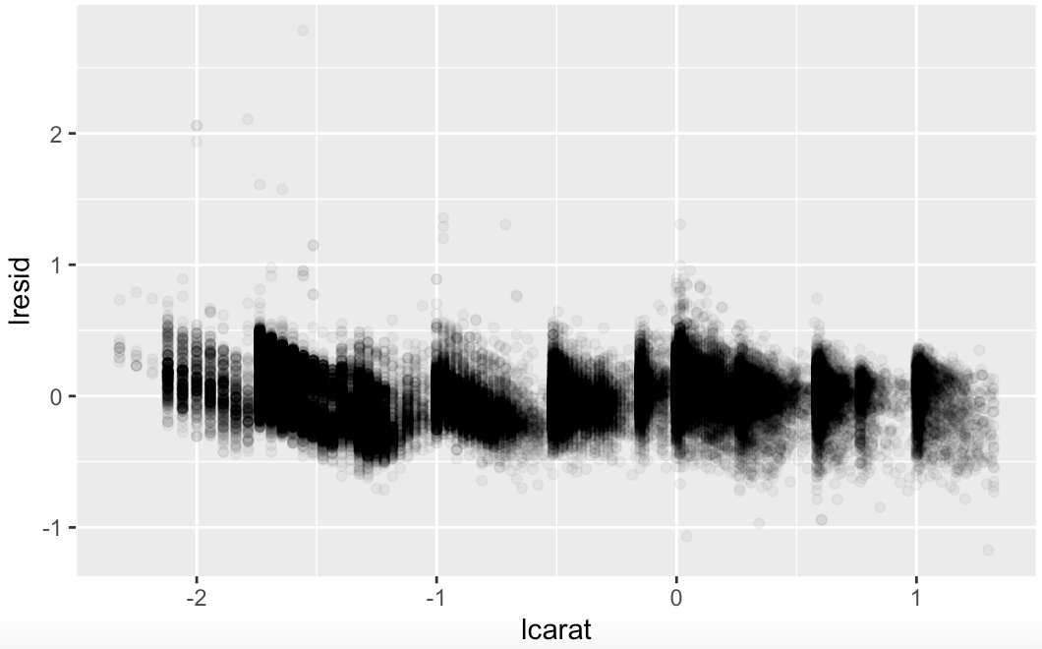
residuals in a more complicated model
Finally, we look at the residuals vs. carat in the model with 4 predictors
Now we see no obvious trend in the residuals
However, some diamonds have quite large residuals

